Slide 1
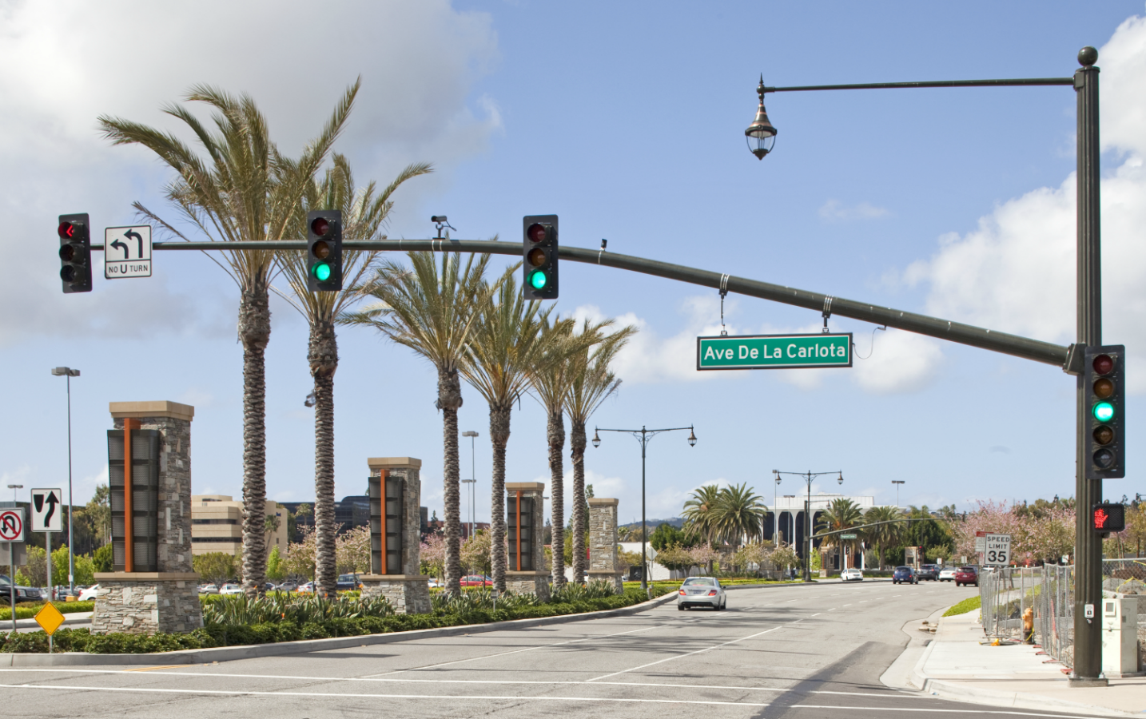
Standard product and POLE TYPES
Aluminum and Steel
© 2017 Valmont Industries, Inc. All rights reserved.

Slide 2
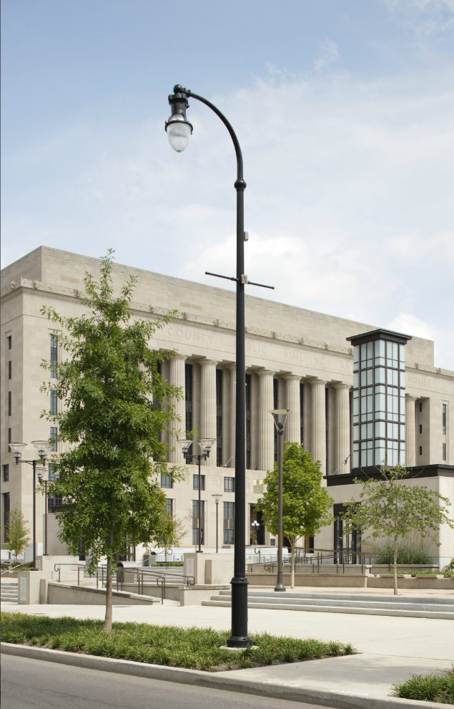
Objectives
Understand the initial considerations when looking for a pole type
Learn the available pole types offered by Valmont
Materials
Round
Square
Hinged
Curved
Identify additional pole components

Slide 3
Pole Considerations
Application
Loading
Height
Where is the pole going to be installed?
Traffic
Roadway
Area Lighting
High Mast
Mass Transit
Sports Lighting
Specialty / Custom
How much loading will be added to the pole?
Fixture(s)
Mounted
Strain
Arms
Traffic Signals
Signs
Banners
What is the preferred mounting height of the fixture going to be?
Material
Steel
Aluminum
Fatigue Risk
Pole Type
Damper

Slide 4
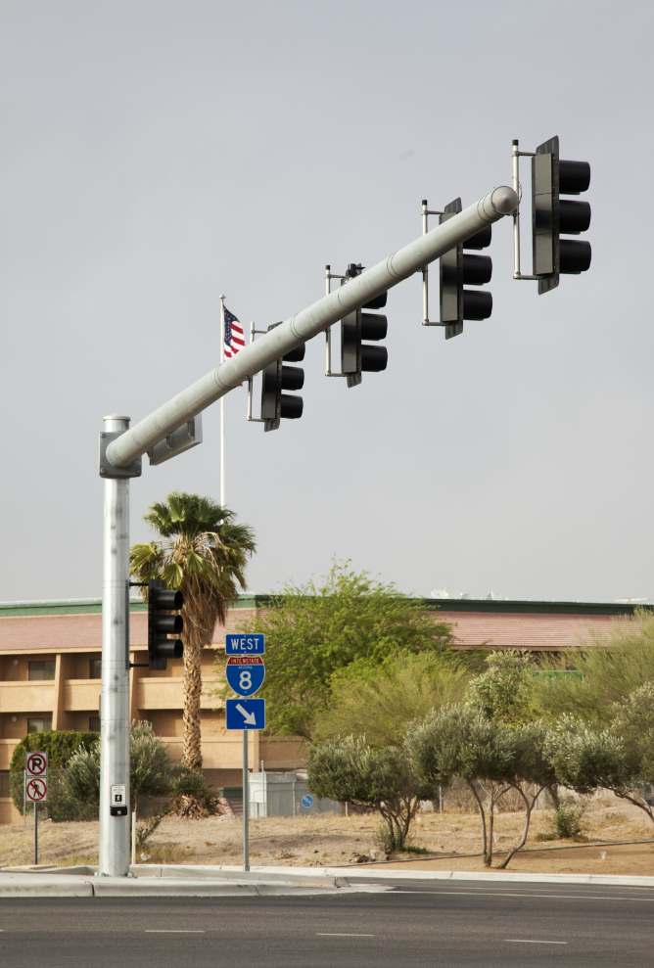
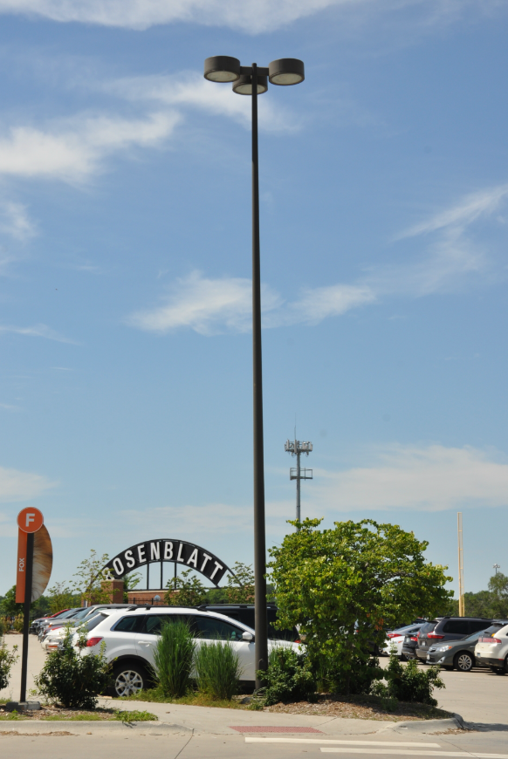
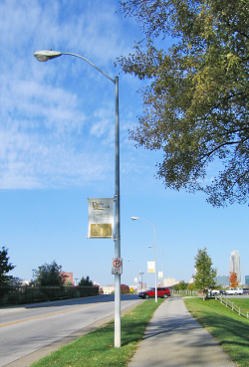
Considerations: Application and Ordering
Application: Traffic / Roadway / Street
Order Process: Request for Quotation (RFQ)
Application: Commercial / Area Lighting
Order Process: Standard price book / Spotlight pricing guide / RFQ
Application: Utility Lighting
Order Process: Standard price book / Spotlight pricing guide / Quoted Contract / Request for Quotation (RFQ)
Notes:
The application of your pole will determine where you look for pricing, and how to order. Traffic, Roadway and street applications will go directly to your PA for an RFQ. Commercial and Utility have a variety of options.

Slide 5
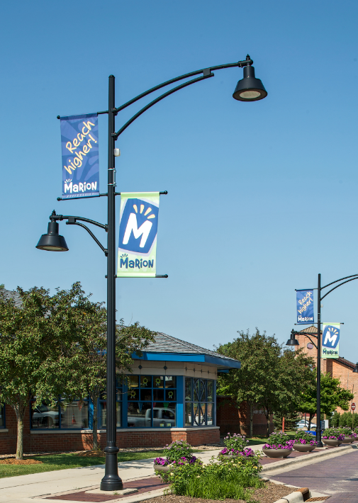
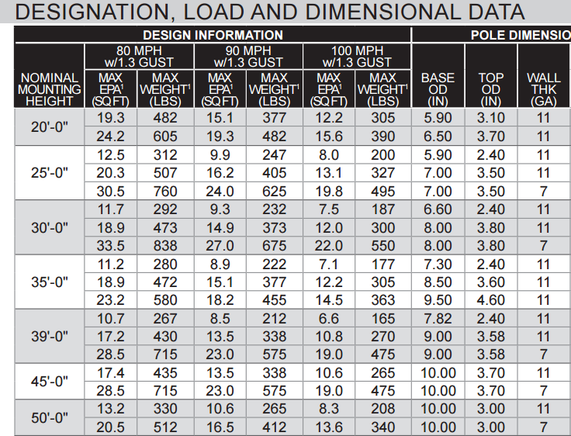
Considerations: Loading / EPA
Pole shapes and heights will have different loading capabilities. If there will be large fixtures, banners, hanging flower pots, or additional add-ons, make sure the pole meets the EPA requirements found on the pole spec sheet.
* If a banners or hanging flower pots are proposed, Valmont will need to size the pole.
+EPA
+EPA
+EPA
+EPA

Slide 6
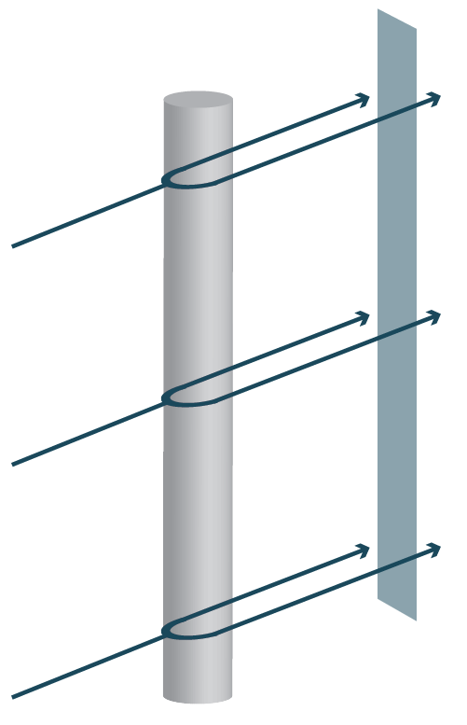
Factors of EPA
Drag
Projected Area
The Effective Projected Area contains two parts:
Drag Coefficient (Object)
The Projected Area
The shape of the object will vary the drag coefficient. The drag coefficient is a calculated multiplier based on the amount of resistance the object has. Any object that will be mounted on the pole will need to be measured.

Slide 7
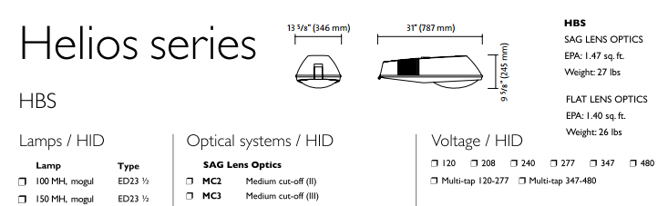
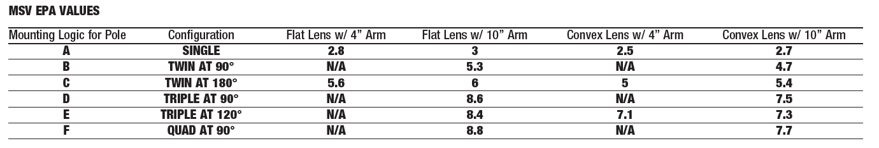
Pole Size Requirements - Fixture
The EPA of a fixture or fixture cluster should be provided by the manufacturer on the product spec sheet.
If the EPA is not clearly stated, reach out to the manufacturer before sizing the pole.
1.47 sq. ft.
1.4 sq. ft.
Philips Cobra Head
Cluster EPA values: Spaulding MSV Series

Slide 8
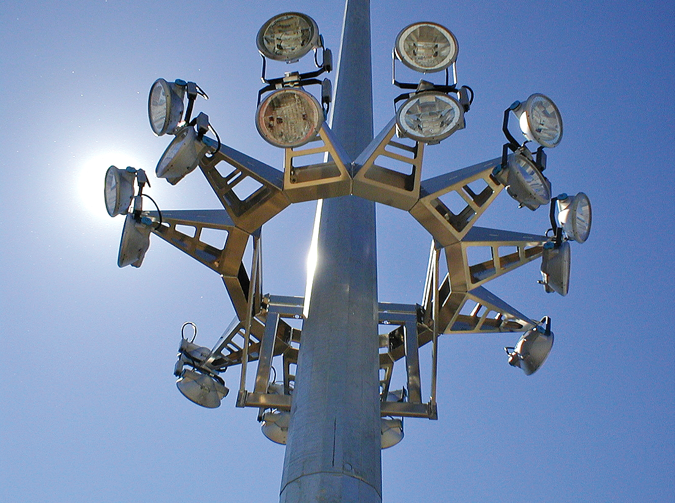
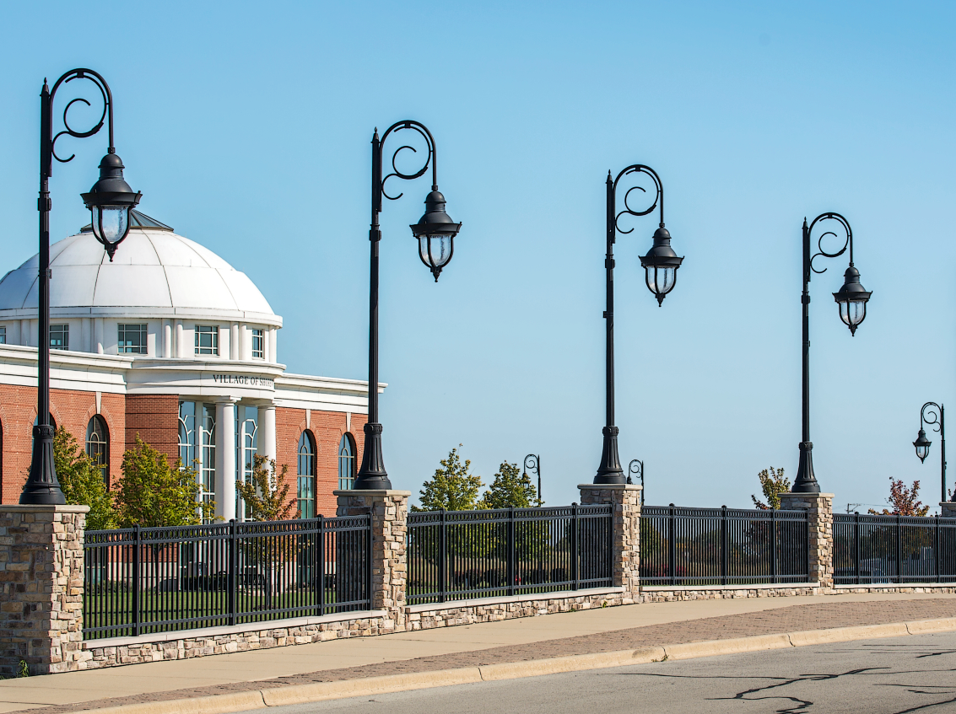
Considerations: Mounting Height
Steel
Aluminum
Shafts up to 50’ single piece or 180’ multi-piece in round tapered
Shafts up to 50’ single piece or 88’ multi-piece
Max straight shaft: 50’
Max taper shaft: 48’

Slide 9
Considerations: Pole Material
Steel
Aluminum
Both
Advantages:
Strength
Less susceptible to vibration
Fabricated base plates
Cost effective at taller mounting heights (above 30’)
Recyclable with low scrap value
Disadvantages:
Corrosive
Heavy – more equipment to install
Advantages:
Corrosion resistant
Light – easy to handle
Flexibility in tapering
Cost effective at lower mounting heights (below 30’)
Disadvantages:
Vibration or fatigue
Damper required on taller or bridge mounted poles
Cast base plates – no customization
Recyclable with high scrap value – damage or theft
Advantages:
Buy America compliant
Multiple shapes available
Multiple finish options
Notes:
Steel –
Taller heights are 30’
Fixed taper rate is .14 per foot – reliable
Alum
Tapering – more shapes and mounting options
Below – 28’
Hard to match existing bolt circles

Slide 10
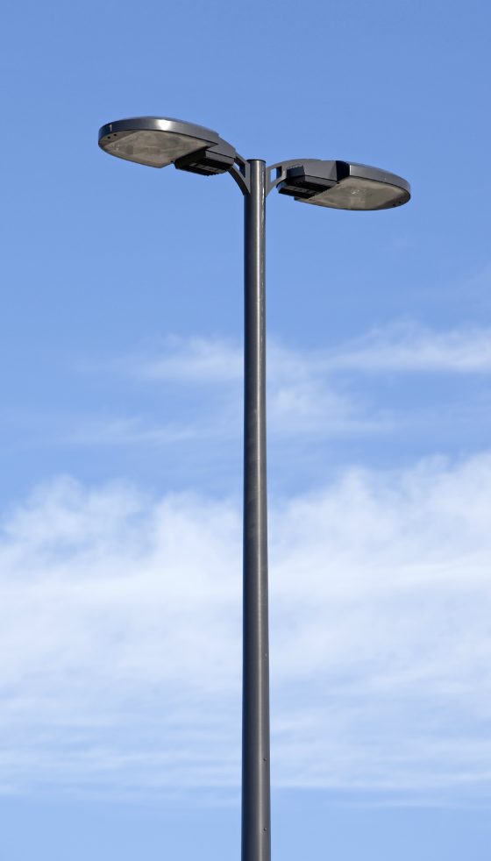
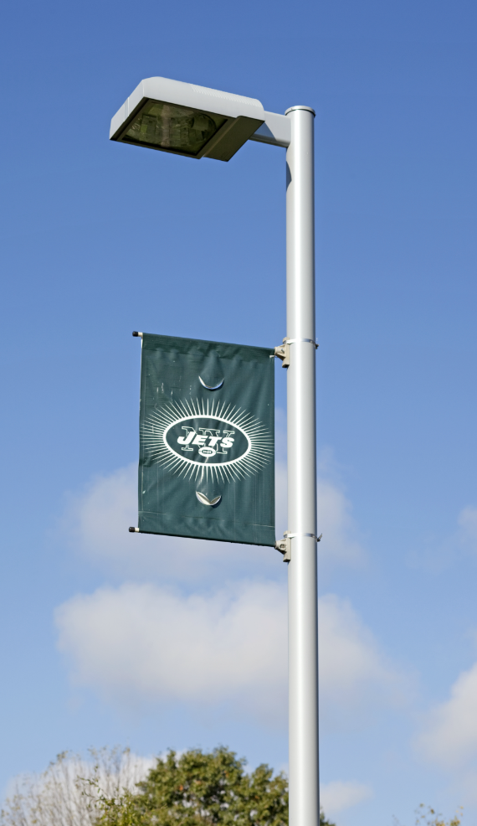
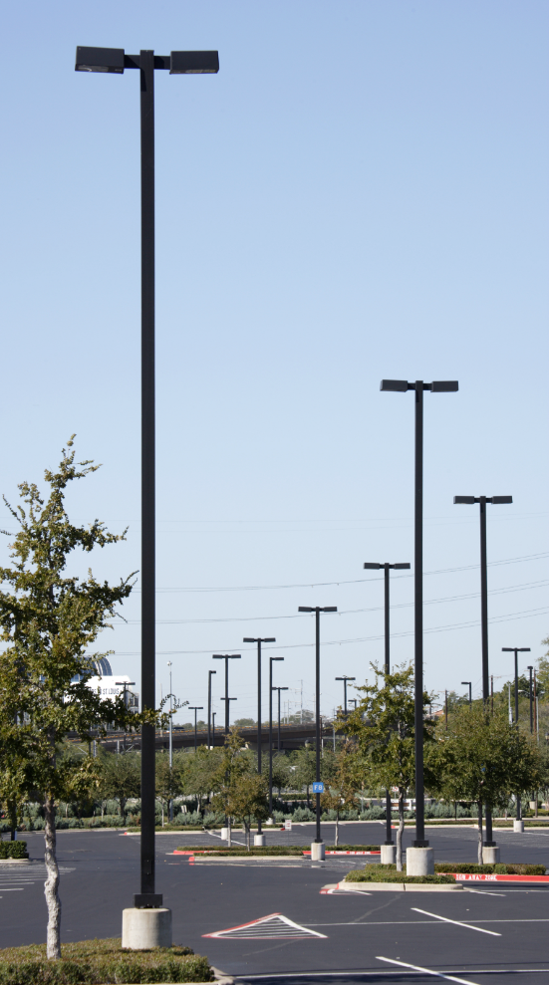
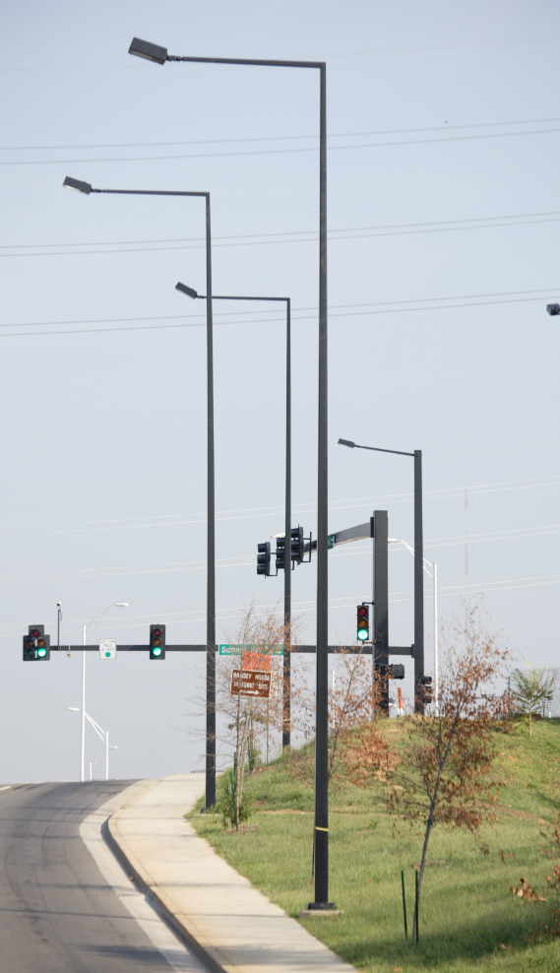
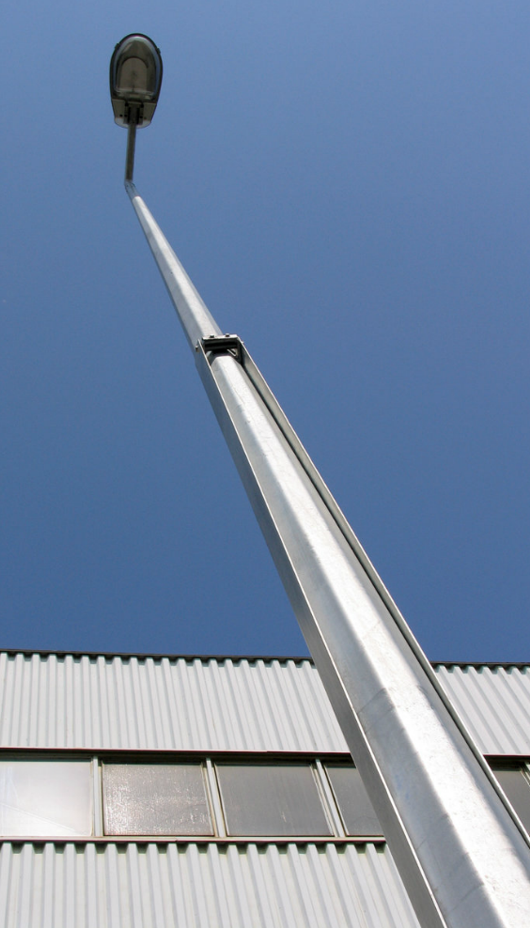
Standard Pole Options
Round Tapered
Straight Round
Straight Square
Square Tapered
Hinged Options
Let’s begin looking at the benefits and drawbacks of each pole type so we can find the best solution for each application.

Slide 11
Steel and Aluminum Pole Types
Pole Type
Material
Round Tapered
Round Tapered Fluted
Round Tapered Hinged
Steel & Aluminum
Steel & Aluminum
Aluminum
Round Non-Tapered (Straight Round)
Round Non-Tapered Fluted
Round Non-Tapered Hinged
Steel & Aluminum
Aluminum
Aluminum
Square Tapered
Square Tapered Hinged
Steel
Steel
Square Non-Tapered (Straight Square)
Square Non-Tapered Hinged
Cruciform
Steel & Aluminum
Aluminum
Aluminum

Slide 12
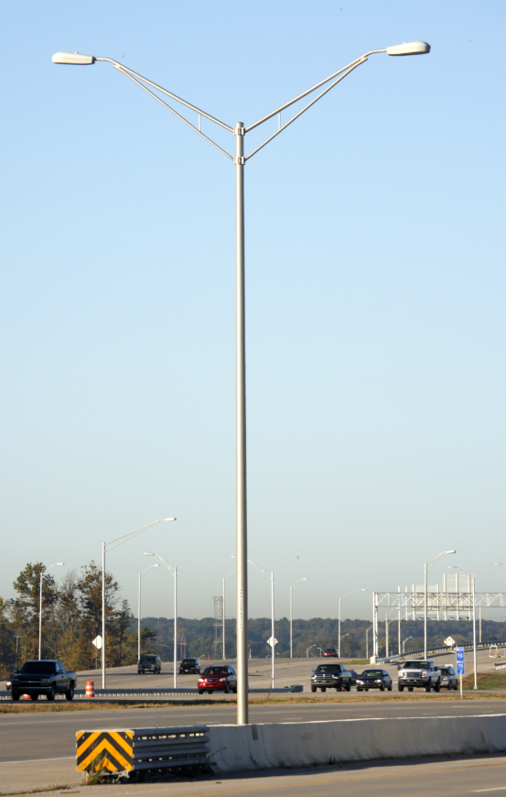
Round Tapered
Benefits
Drawbacks
Available in steel (RTS) and aluminum (RTA)
Taller mounting heights - Up to 70 Feet
Able to vary wall thickness of sections
Potentially fewer poles required
Variety of finishes
Will handle substantial loading
More expensive than straight rounds
Notes:
Very popular
RTS and RTA are industry terms
2 piece poles to 70’
Vary wall thicknesses – save money
Save money by installing fewer poles and fixtures

Slide 13
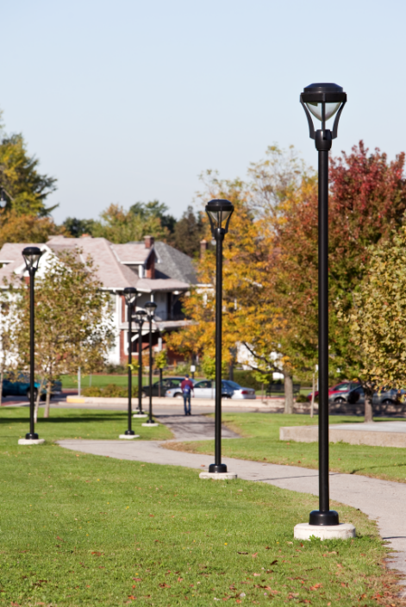
Straight Round
Benefits
Drawbacks
Available in steel (SRS) and aluminum (RNTA)
Price effective
Variety of finishes
Readily available
Less prone to vibration problems
Height limitations
Loading limitations
Notes:
Very popular
Easy to manufacture
Short round poles are less susceptible for vibration

Slide 14
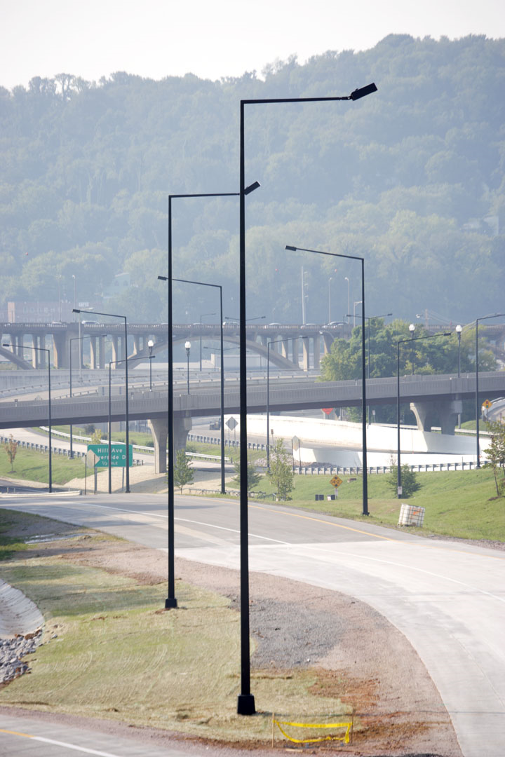
Square Tapered Steel
Benefits
Drawbacks
Sleeker square pole aesthetics
Variety of finishes
Taller mounting heights - Up to 50 Feet
Will handle more loading than Straight Square
Limited competition
Spec lock opportunity
Only available in steel (STS)
More expensive than the Straight Square
Longer lead-times
Notes:
Common in area lighting – stay consistent
Blend area and street
50 will be 2 pieces – anything above 40’ check spec page

Slide 15
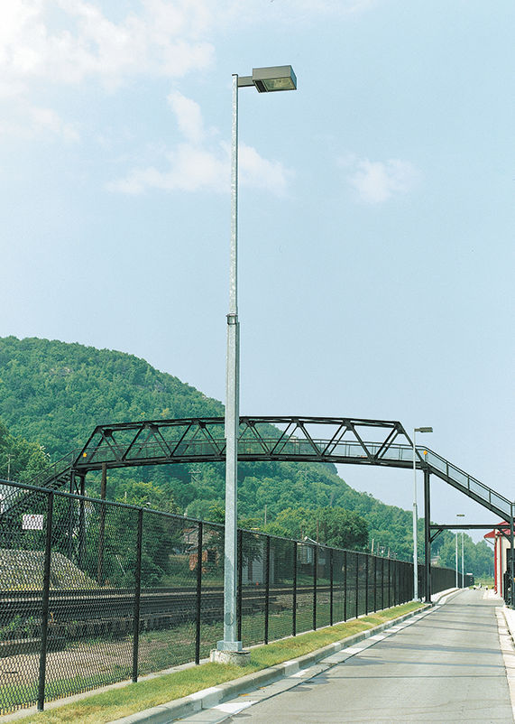
Hinged Poles
Benefits
Drawbacks
Available in aluminum for short poles and steel for taller applications.
Able to break-over pole to perform fixture maintenance.
Variety of finishes
Available with either internal, external, or base hinge
Limited competition – Spec lock opportunity
Height limitations – Up to 40 feet
More expensive
Longer lead-times
Prone to fatigue failure
Dimensions are fixed: no customization for heights or fixtures
Notes:
Not very common
Works well in tight spaces where you cant bring equipment
Spec options
Dimensions are fixed and cannot be custom

Slide 16
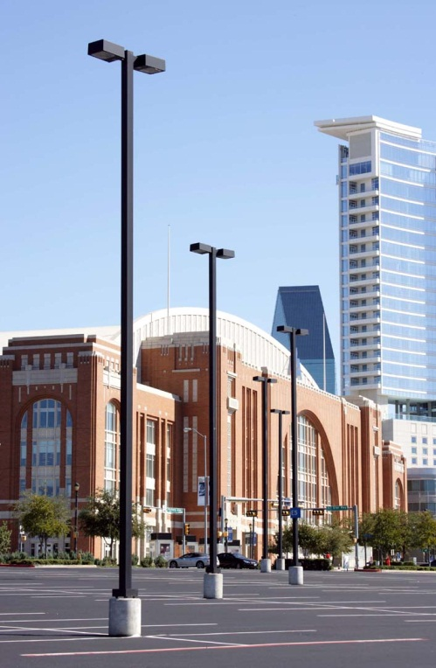
Straight Square
Benefits
Drawbacks
Available in steel (SSS) and aluminum (SNTA)
Price effective
Variety of finishes
Readily available
Height limitations
Loading limitations
Susceptible to vibration or fatigue
Notes:
Commodity product
Most loading limitations

Slide 17
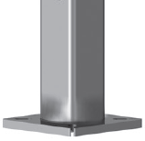
Fatigue Resistant Soft Square (FRSS)
Patented fatigue resistant soft square design eliminates the four square corners (stress risers) by belling the square cross section to round
The belled section is hidden under a low profile base cover
7-8X MORE FATIGUE RESISTANT THAN STANDARD SQUARE POLES!
Notes:
Standard for all square steel poles
Cannot see it – under cover

Slide 18
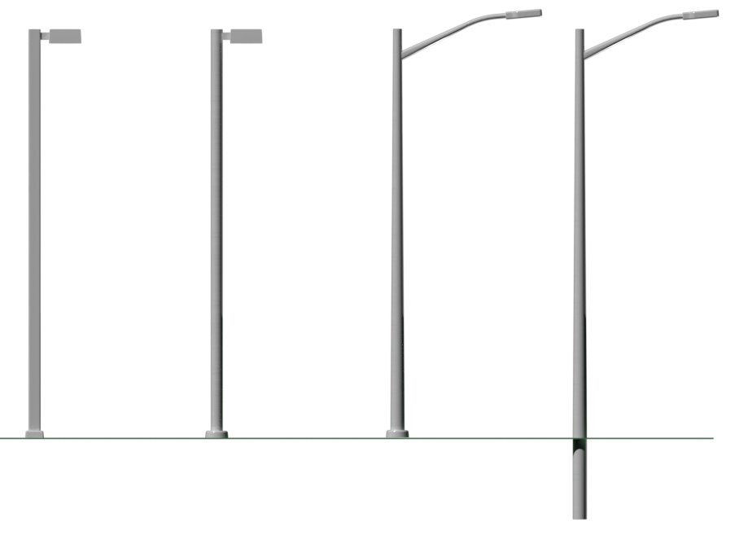
Considerations: Fatigue Risk
HIGHEST RISK > > > > LOWEST RISK
Straight Square Straight Round Round Tapered Round Tapered Embed
Notes:
Even with bell shaped curve – SS is most
Round taper with anchor base

Slide 19
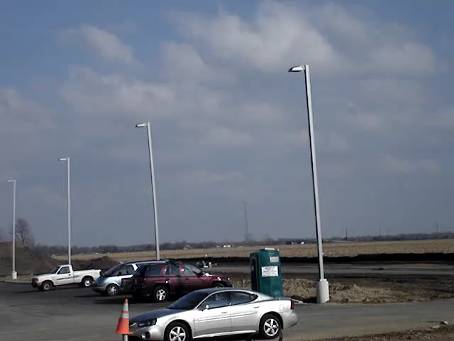
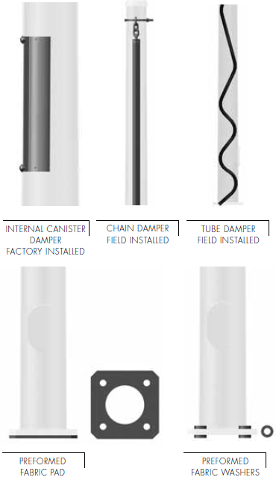
Vibration Mitigation Devices
Most common damper devices
Good at reducing vibration from low but constant wind
The pole must be removed to install the rubberized washers
Notes:
Very low breeze but constant
At the very end you see pole that’s not moving
Difference – fixture is mounted at different angle
Options for mitigation devices – factory canister device and fixed to inside of pole. Spring moves and absorbs vibration
Chain and snake are installed in field – snake fills gaps in pole
Pads mount to bottom of pole – must uninstall pole to put in place. Rubberized washers
If you have any ?s contact your PA or Field Services rep for best options

Slide 20
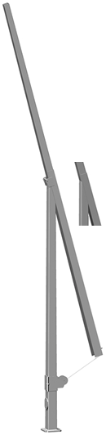
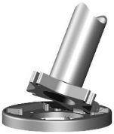

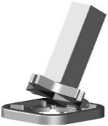
Review: Steel and Aluminum Pole Types
Round Tapered
Straight Round
Square Tapered
Straight Square
Hinged Poles
Plain (St & Al) Fluted (St & Al)
Plain (St & Al) Fluted (St & Al)
Plain (St)
Plain (St & Al) Cruciform (Al)
Round Tapered (Al) Straight Round (Al) Square Tapered (St) Straight Square (Al)
Notes:
Standard product offering – most available in alum and steel
Round available in fluted
Straight square – cruciform
Hinged in both mats

Slide 21
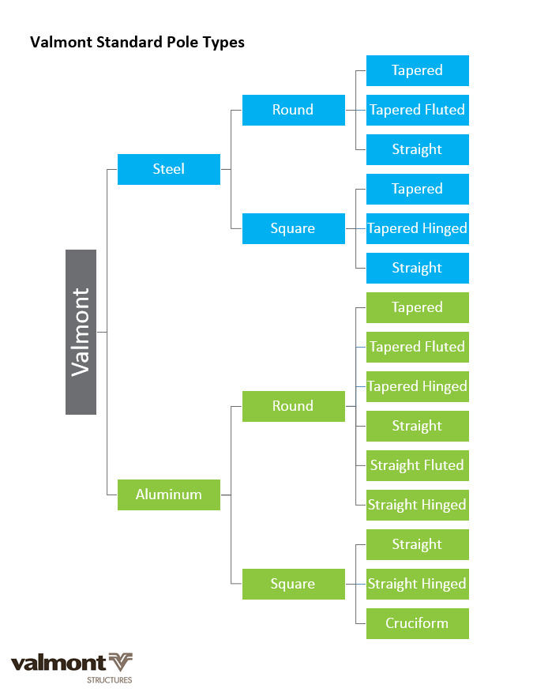
Cheat Sheet: Standard Pole Types

Slide 22
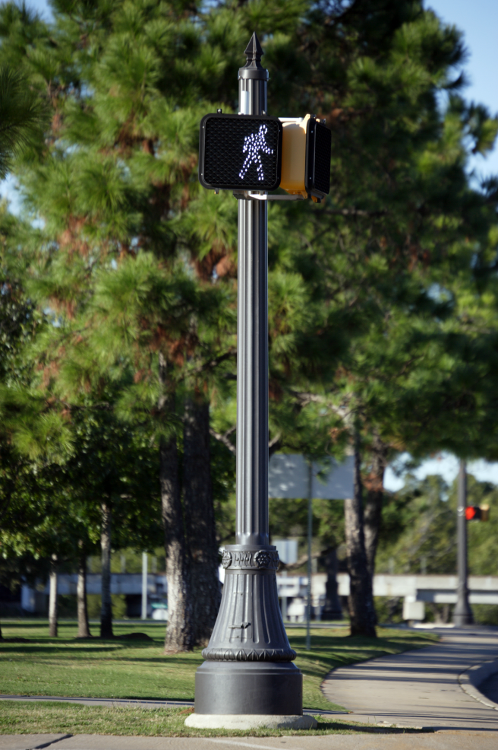
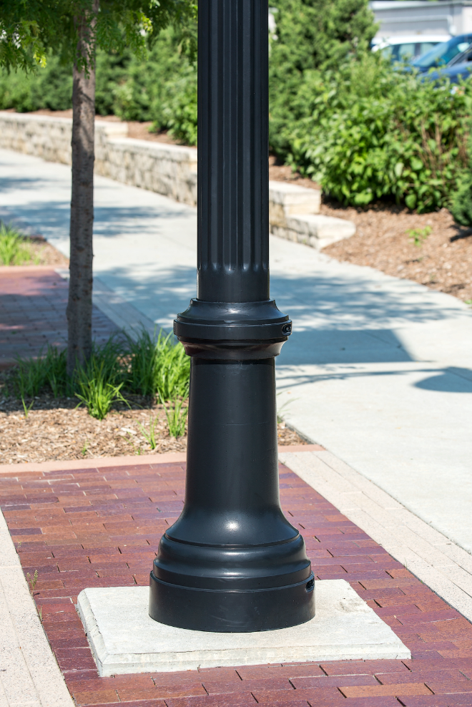
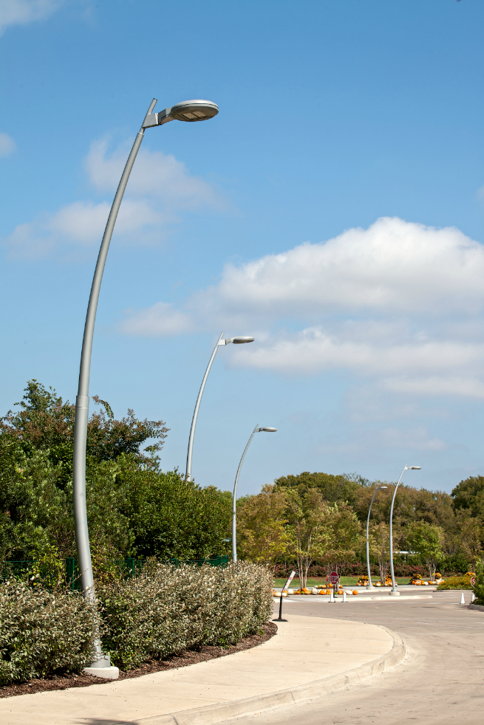
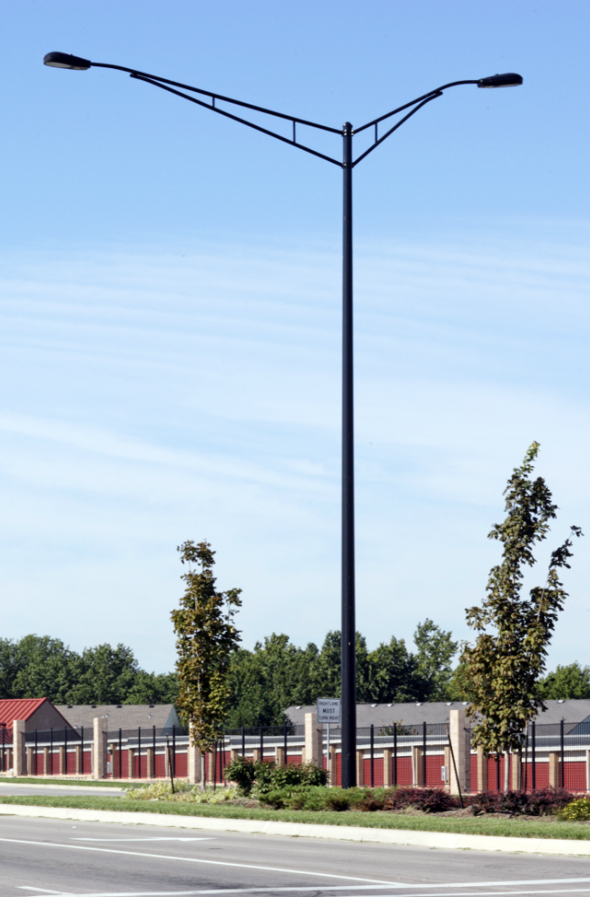
Additional Shapes and Assemblies
Posts and Bases
Fluted Poles
Curved Aluminum Options
Arm Assemblies

Slide 23
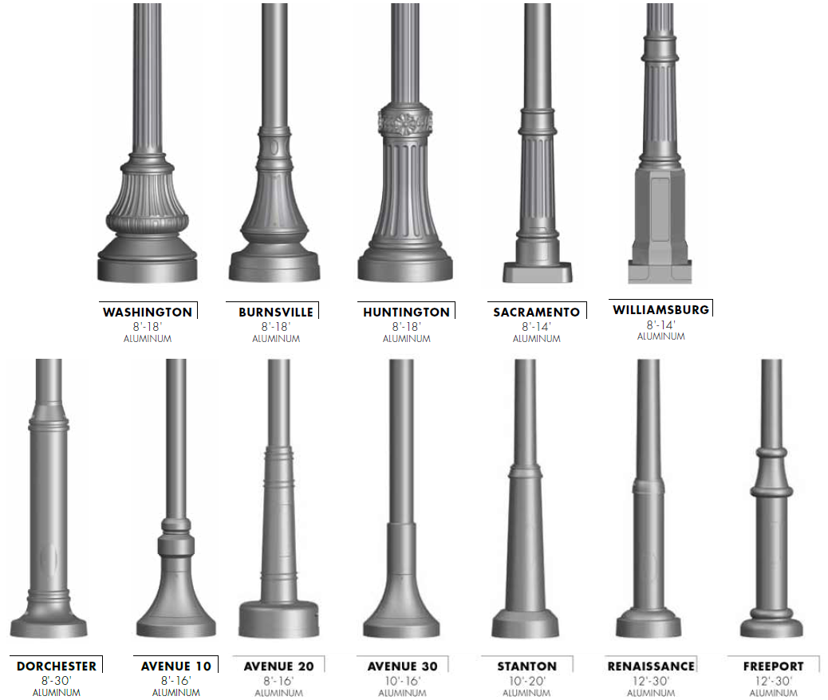
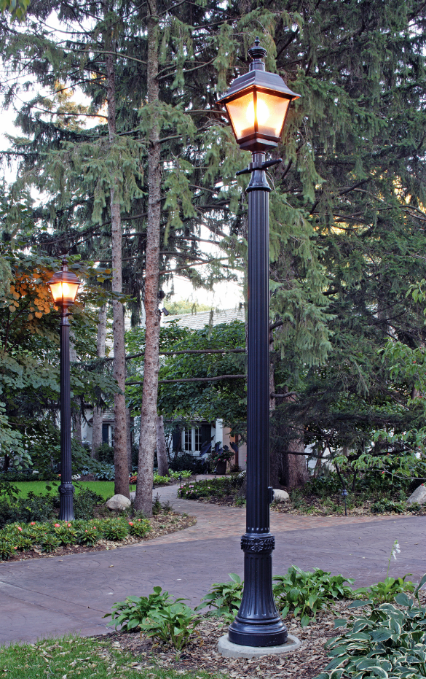
Historic and Contemporary Posts
Posts
One piece design
Base and post welded together
Built in handhole for easy installation on anchor bolts
Fluted or non-fluted shafts
*The full product line is not represented.
Notes:
One piece designs available in round st. round tape flute or smooth

Slide 24
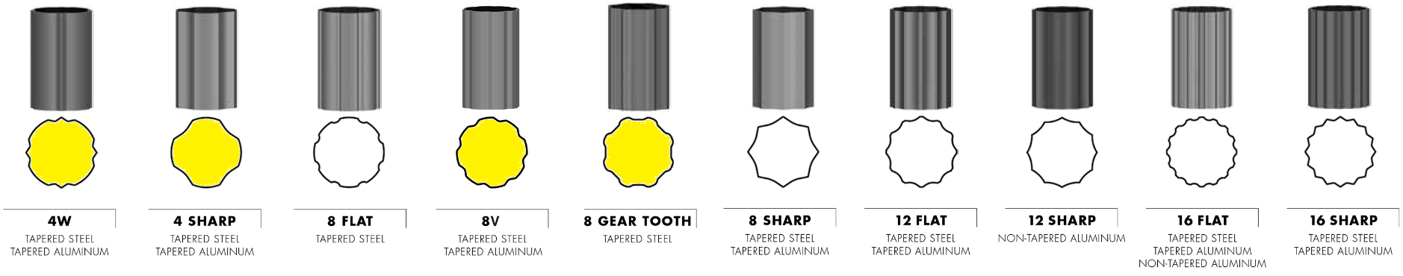
Flute Options
Valmont offers the most flute options in the industry
Clean, crisp, and uniform flute transitions
Ability to start and stop anywhere along the pole shaft
Yellow = Valmont specific shape
Notes:
Valmont offers most options in industry
4 in yellow are proprietary to Valmont – spec lock

Slide 25
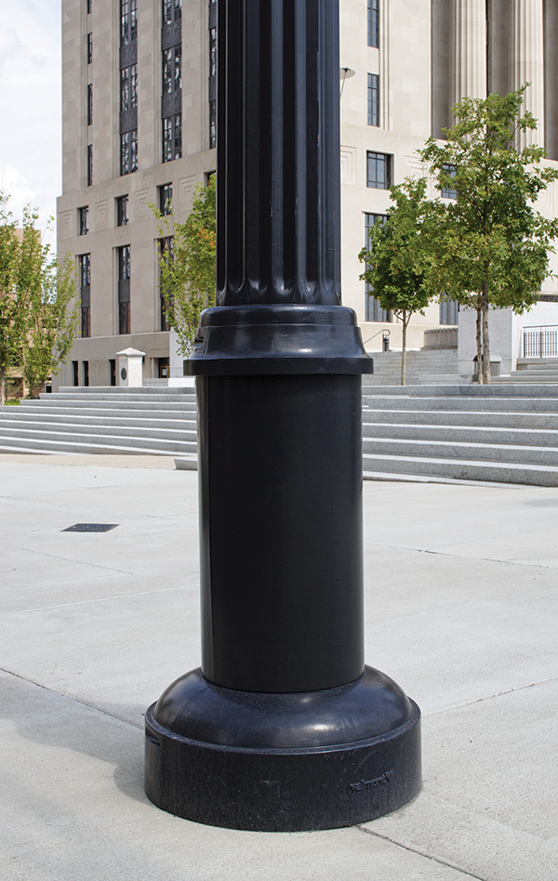
Flute Options
Accommodate Top and Side Mounting Fixtures and Arms
Start and Stop Flutes
Accommodate Decorative Bases
Notes:
Flute to base plate – good with nut covers
Flute with base cover – we can stop the flute and keep it smooth. Tighter seal - spec lock

Slide 26
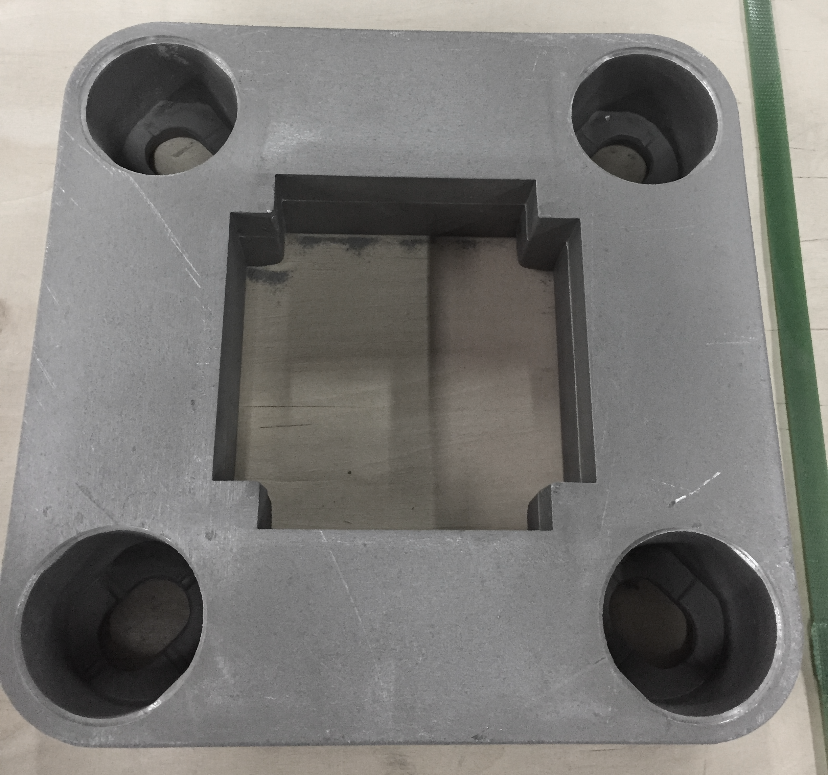
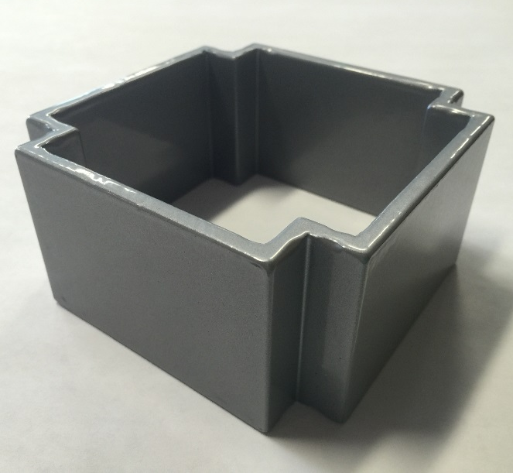
Square Aluminum Shapes
Benefits
Drawbacks
Decorative
Limited competition
Limited sizes
4” and 6” squares
Cannot start and stop shape
Prone to fatigue failure

Slide 27
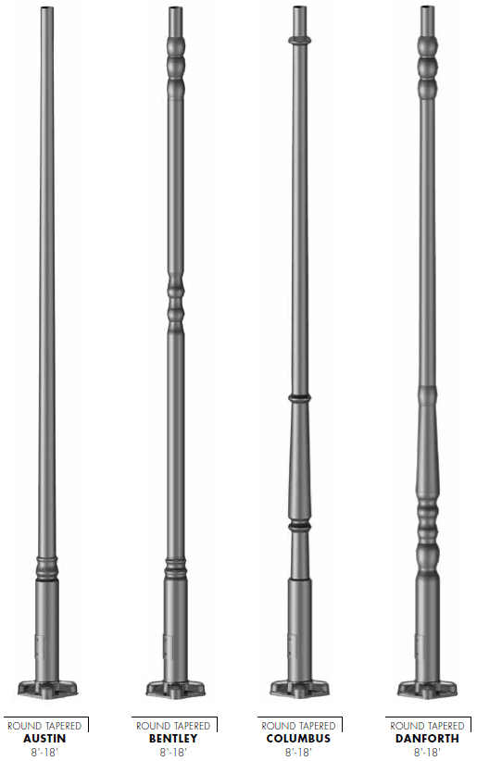
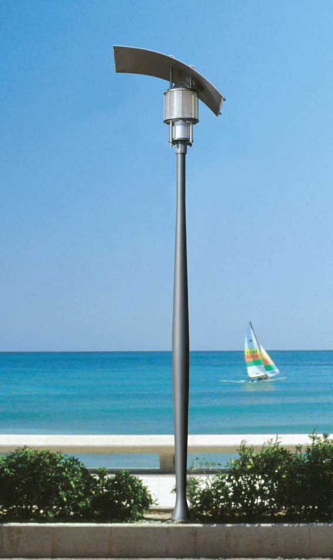
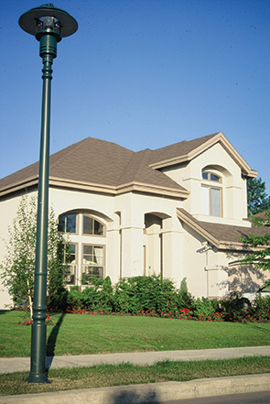
Round Aluminum Shapes
Notes:
Part of standard catalog
Only 4 options but we do lots of custom profiles
Spec lock opportunity
We can do this bc we own the extrusion facility and can taper at our own facility in a variety of sizes

Slide 28
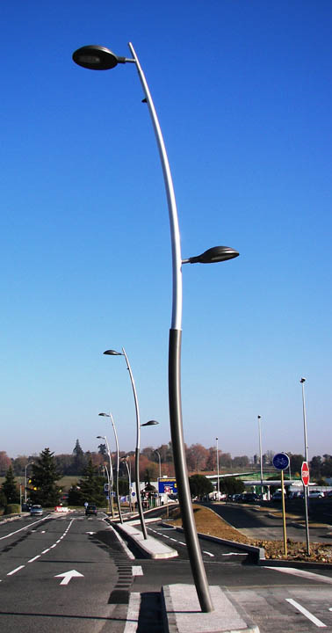
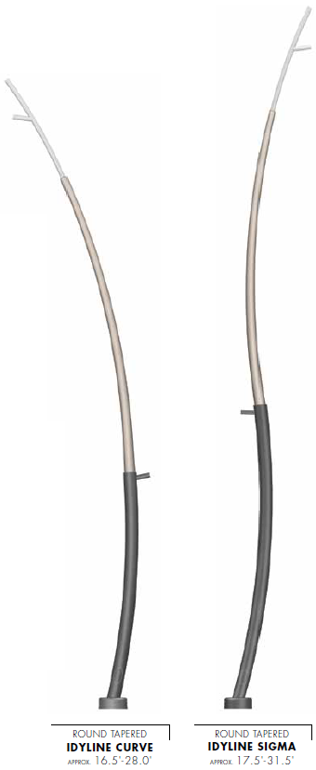
Idyline – Round Tapered Curved Aluminum
Notes:
Standard offering
Affordable
Street and ped
2 tones or single
If you have higher mounting heights, you can try our new curved steel poles

Slide 29
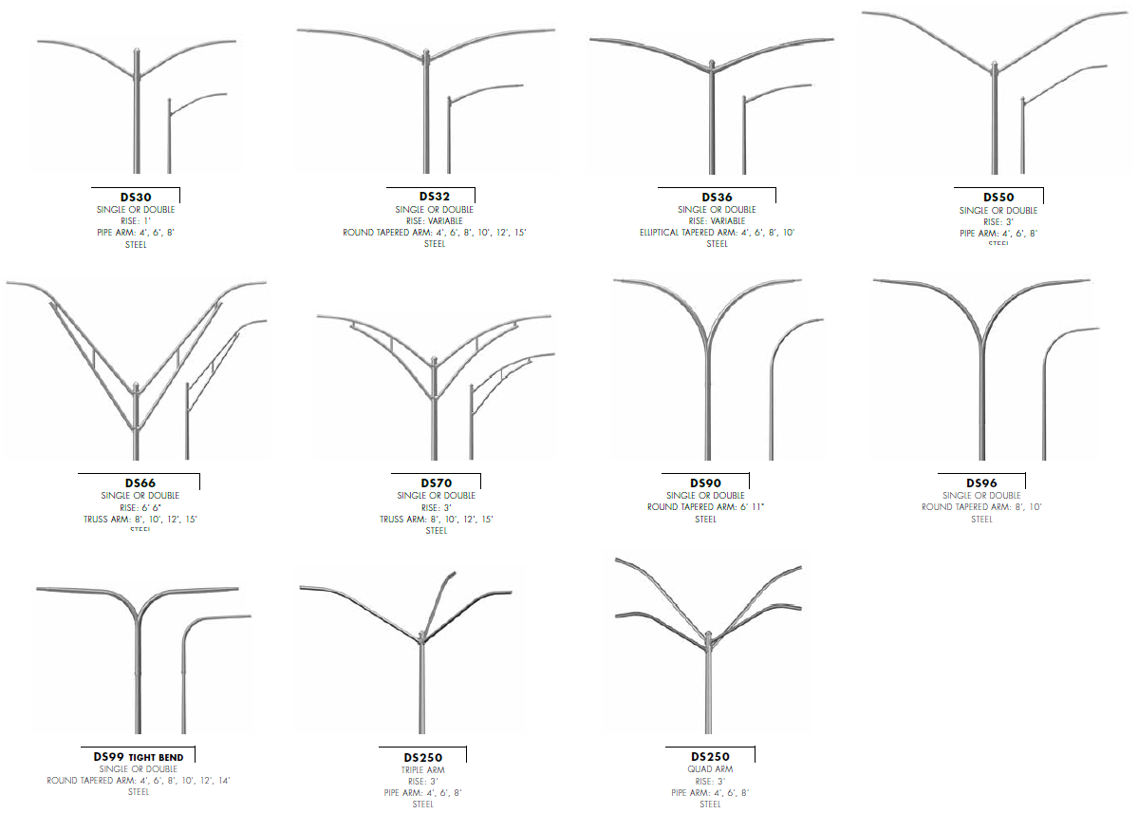
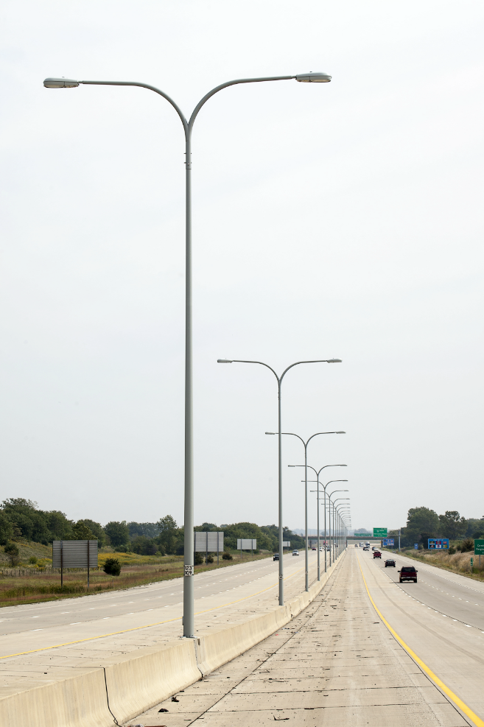
Standard Steel Arm Assemblies
*The full product line is not represented.
Notes:
Assemblies = Round tapered with arm or 2 arms for street applications or roadway
We can also do custom work

Slide 30
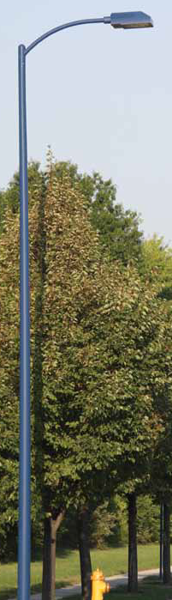
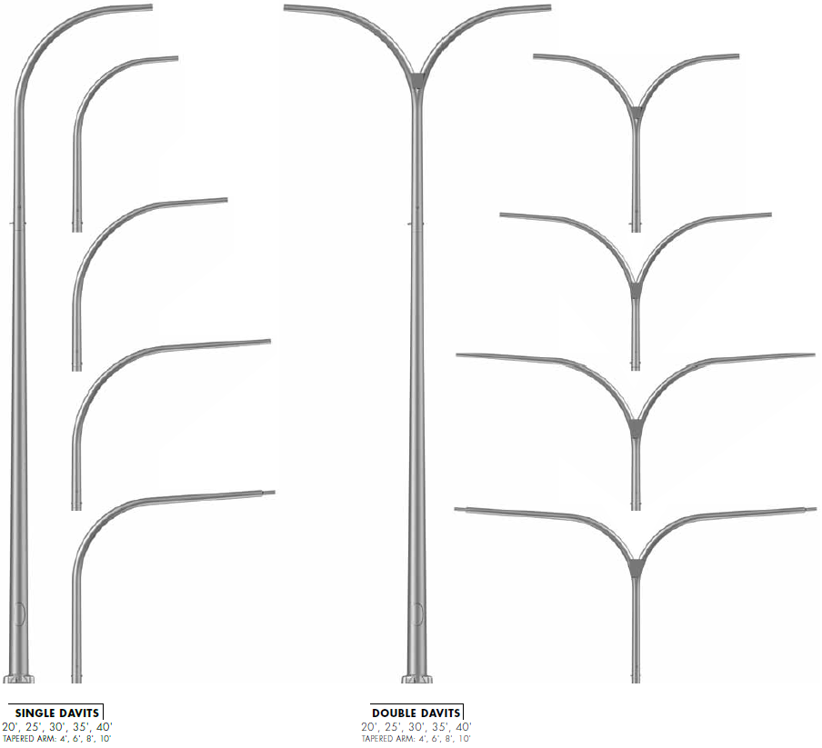
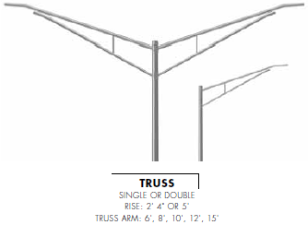

Standard Aluminum Arm Assemblies
*The full product line is not represented.
Notes:
You can mix and match and it will look similar in both applications.
Flex in materials and mounting heights

Slide 31

Steel and Aluminum Brackets
* Only steel brackets pictured
Notes:
Valmont also provides steel and aluminum brackets. Here are the standard steel brackets, but just like arm assemblies, there are very similar options in aluminum as well.

Slide 32


Arm Attachments and Fixture Mountings
Steels Poles
Aluminum Poles

Slide 33





Bases and Covers
Nut Cover
Standard Base
Transformer Base
Decorative Base
Breakaway Base
Notes:
There are several ways to modify the base of a pole. Lets go over these individually.

Slide 34

Nut Covers
Notes:
Nut covers are good alternative to those who don’t want to use standard tbases or base covers.
Don’t want to use standard steel tbase or base covers
Fluted comes standard with fluted
Shoebase is standard with alum poles if you do not get base cover

Slide 35


Round and Square Dart Base Covers
Round Dart – 3.00”-17.00”
Square Dart – 4.00”-10.00”
Notes:
The aluminum dart base covers are technically a decorative base but theyre a nice upgrade from our standard plastic base covers. They come in a large range of sizes to accommodate most standard products.
Technically decorative bases
Nice base cover – up from standard

Slide 36

Transformer Bases and Breakaway Options
Non-breakaway
Options
Breakaway
Options
Notes:
Most commonly found in street or traffic areas Tbases are another way to mount your pole to your anchorbolts. The M211 and M212 are steel and will not breakaway. The tbases below are aluminum and will breakway. You can use these for either steel or aluminum poles. If you don’t like the look of Tbases and still need breakaway functionality, you can use the couplings here on the right.
M211 and m212 are steel – street/traffic
Steel will NOT breakaway
TB is alum and will all breakaway
if you don’t want tbase breakaway – use couplings

Slide 37



Handholes and Festoons

Slide 38


Non-Standard Poles
Remember:
If your design cannot be created using the standard products with ‘adders’ and ‘deducts’ in the steel or aluminum price books, make sure to reach out to your Project Administrator for a quote.
All traffic, sports lighting, high mast, mass transit, and custom work will need to be reviewed by Valmont.

Slide 39
THANK YOU!
valmontstructures.com

